Slide 1
A Reproducible SQL-Driven Pipeline for Oral Microbiome Analysis and Visualization of Genus-Level Biomarkers in Depression
Daun Kim
BMI 8540 Final Project

Slide 2
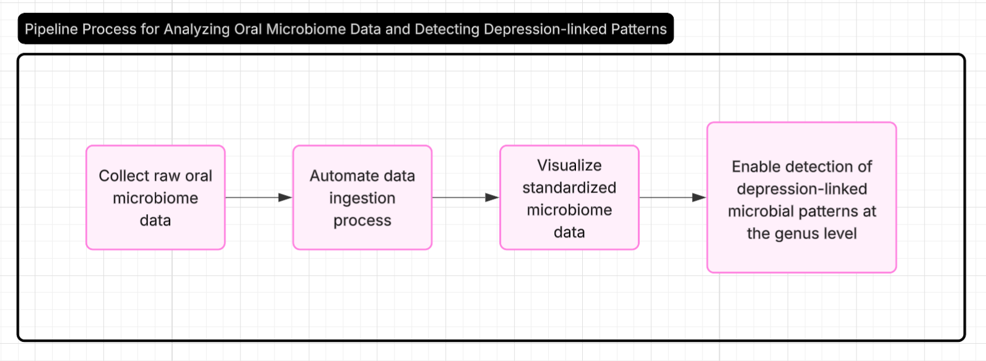
Purpose

Slide 3
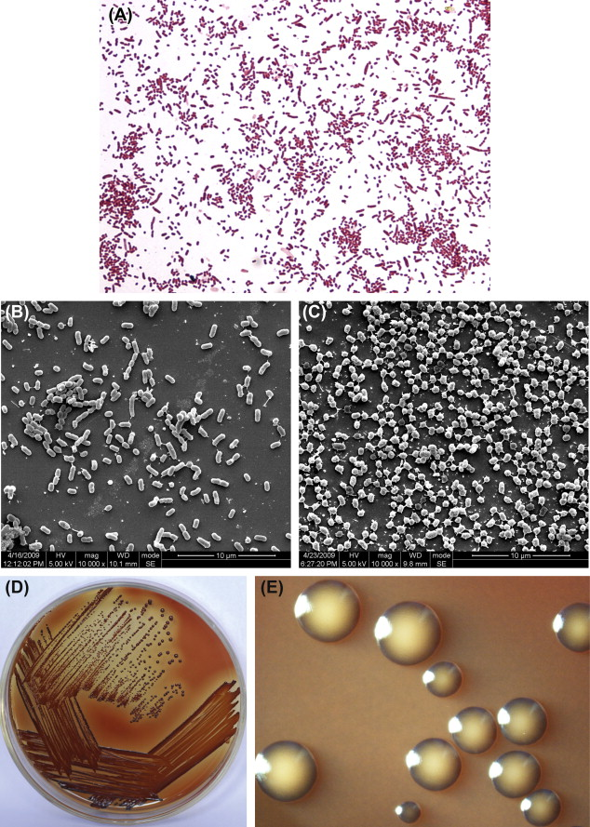
Background
Certain genera, like Prevotella and Porphyromonas, are more abundant in people with depression.
These bacteria are also associated with pro-inflammatory responses.
Oral microbiome profiles might serve as non-invasive biomarkers for mental health screening in the future.
Source: ScienceDirect Topics on Prevotella

Slide 4
Background
Basic microbiome biology and significance of 16S rRNA data
Fundamentals of SQL database schema and normalization
Basic Python scripting for data parsing and visualization
Shell scripting for automation and reproducibility

Slide 5
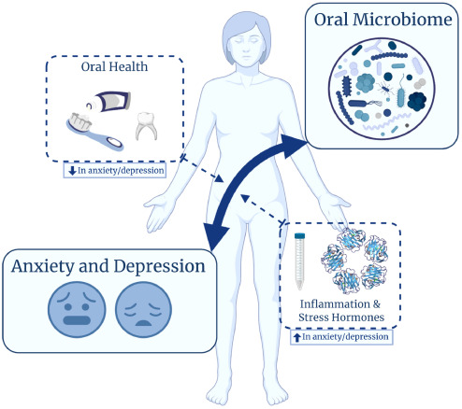
Significance of the Project
Depression is often underdiagnosed, especially in early stages
Oral microbiome offers a non-invasive biomarker avenue
A reproducible bioinformatics pipeline aids in scalable analysis for research
Source: ScienceDirect

Slide 6
Novelty of the Project
Integrates public microbiome dataset with depression status
Unlike existing tools (NCBI or QIIME2),
Lightweight Modular (SQL + Python + Bash)
Tailored for a specific clinical hypothesis

Slide 7
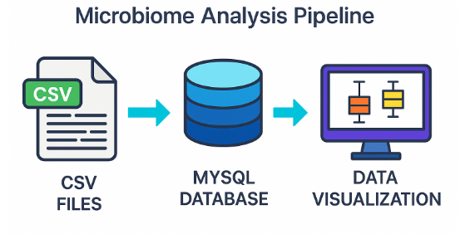
Project Components

Slide 8
Project Functions
Import genus-level relative abundance data
Load sample metadata (depression status)
Store structured data in MySQL
Generate boxplot visualizations for Prevotella genus

Slide 9
Demonstration
Code
PIPELINE
Documentation

Slide 10
Lessons Learned Outside My Scope of Knowledge
Installed and configured MySQL Server and Workbench
Learned SQLAlchemy for Python-to-SQL interfacing
Used Pandas for real-time database querying and plotting

Slide 11
Challenges Encountered
My scope was too big too ambitious in the beginning
I had to minimized my project scope and worked on it little every week.
Lock wait timeout errors with large dataCSV formatting and column parsing issues
Learned to chunk rows to handle large datasets
My original dataset was too big and needed processing
I had to tweak my topic to focus on a small dataset that was available

Slide 12
Improvements with More Time and Resources
Add
Web-based GUI
Integrate
Support for larger FASTA datasets
Expand
More genus types
Deploy
On cloud for collaborative research

Slide 13
Conclusions
Built a working, reproducible pipeline for oral microbiome analysis
Demonstrated capability to process real oral microbiome data and generated clinically relevant visualization
Future Directions: Link to taxonomy, scale to full oral microbiome dataset
Great learning experience in bioinformatics tooling & scripting
Tool can be adapted for other general and conditions

Slide 14
References
Dataset Source: Kaggle - Oral Microbiome in Depression and Non-Depression
https://github.com/daunkim18/BMI-Programming/tree/main

Slide 15
Thank You for Listening
For any questions,
contact daunkim@unaomah.edu

